Slide 1
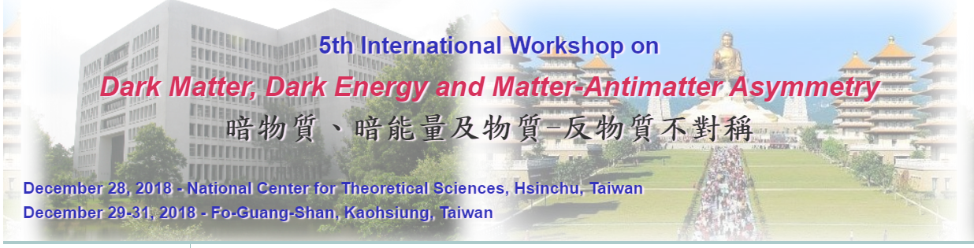

Constraining neutrino electromagnetic properties using Xenon detectors
Chung-Chun Hsieh
National Taiwan University
Collaborators:
Prof. Jiunn-Wei Chen, Dr. Chih-Pan Wu, Dr. Mukesh K. Pandey (NTU),
Prof. Cheng-Pang Liu, Prof. Hsin-Chang Chi (NDHU),
Dr. Lakhwinder Singh and Prof. Henry T. Wong (AS)

Slide 2
Outline
Introduction
  Motivation (neutrino physics & DM xenon detector)
Formalism
  Ab initio atomic calculation
Results
  Differential cross section
  Constraining values
Summary

Slide 3

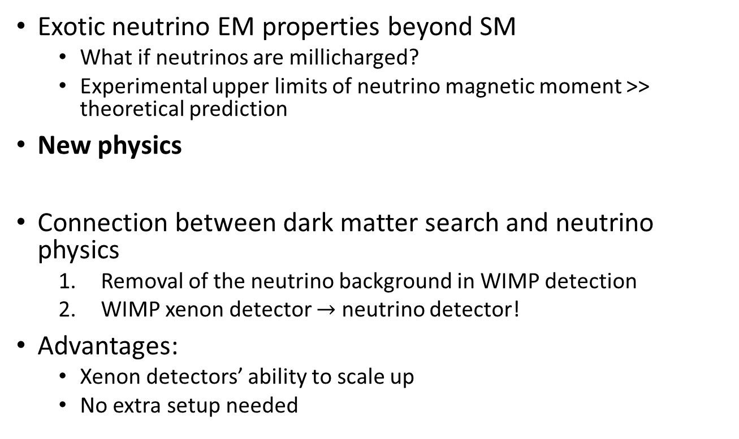
Introduction
Exotic neutrino EM properties beyond SM
  What if neutrinos are millicharged?
  Experimental upper limits of neutrino magnetic moment >> theoretical prediction
New physics
Connection between dark matter search and neutrino physics
  Removal of the neutrino background in WIMP detection
  WIMP xenon detector $→$ neutrino detector!
Advantages:
  Xenon detectors’ ability to scale up
  No extra setup needed
$$ν+A→ν+A^{+}+e^{−}$$
Better constraints?
M. Tanabashi et al. (Particle Data Group), Phys. Rev. D 98, 030001 (2018)
A. G. Beda et al., Phys. Part. Nucl. Lett. 10, 139 (2013).
J. Billard et al., Phys. Rev. D 89, 023524 (2014), arXiv:1307.5458 [hep-ph].

Slide 4

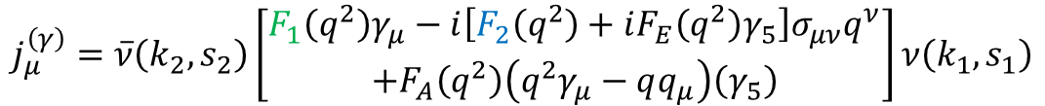

Formalism
The associated EM current:
Constraining millicharge & magnetic moment interaction
$$j_{μ}^{\left(γ\right)}=\overline{ν}\left(k_{2},s_{2}\right)\left[\begin{aligned}F_{1}\left(q^{2}\right)γ_{μ}−i\left[F_{2}\left(q^{2}\right)+iF_{E}\left(q^{2}\right)γ_{5}\right]σ_{μν}q^{ν} \\ +F_{A}\left(q^{2}\right)\left(q^{2}γ_{μ}−qq_{μ}\right)\left(γ_{5}\right)\end{aligned}\right]ν\left(k_{1},s_{1}\right)$$
$$δ_{Q}=F_{1}\left(0\right)$$
$$μ_{ν}=F_{2}\left(0\right)$$
J.-W. Chen, H.-C. Chi, K.-N. Huang, H.-B. Li, C.-P. Liu, L. Singh, H. T. Wong, C.-L. Wu, and C.-P. Wu, Phys. Rev. D 91, 013005 (2015), arXiv:1411.0574 [hep-ph].

Slide 5
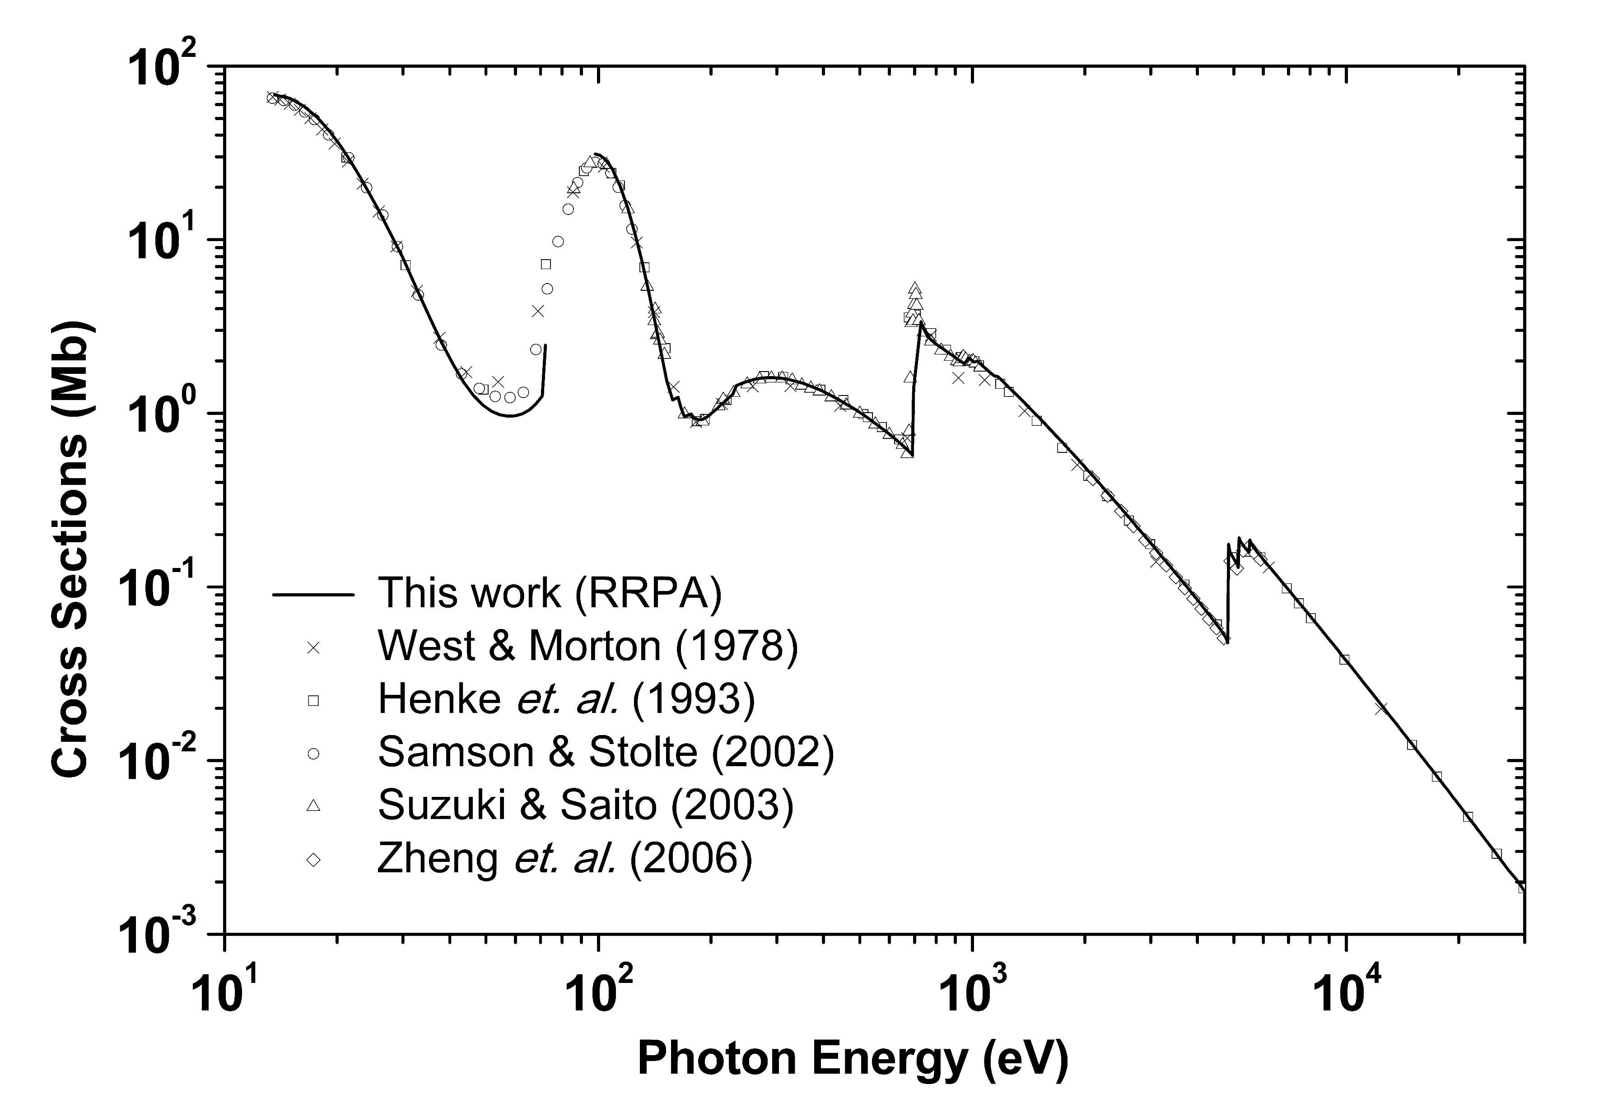
Atomic calculation
Atomic effect become important
Ab initio method: Relativistic Random Phase Approximation, RRPA (containing many body effect, e.g. 2 e⁻ correlation, and relativistic effect).
Benchmark calculation: Xe photoabsorption
Error within 5%, good approximation
J. B. West and J. Morton, At. Data Nucl. Data Tables 22 (1978) 103.
B. L. Henke, E. M. Gullikson, J. C. Davis, At. Data Nucl. Data Tables 54 (1993) 181.
J. Samson, W. Stolte, J. Electron Spectrosc. Relat. Phenom. 123 (2002) 265.
I. H. Suzuki, N. Saito, J. Electron Spectrosc. Relat. Phenom. 129 (2003) 71.
L. Zheng, M. Cui, Y. Zhao, J. Zhao, K. Chen, J. Electron Spectrosc. Relat. Phenom. 152 (2006) 143.

Slide 6
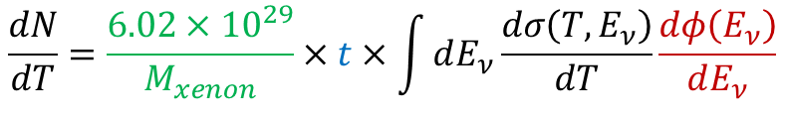
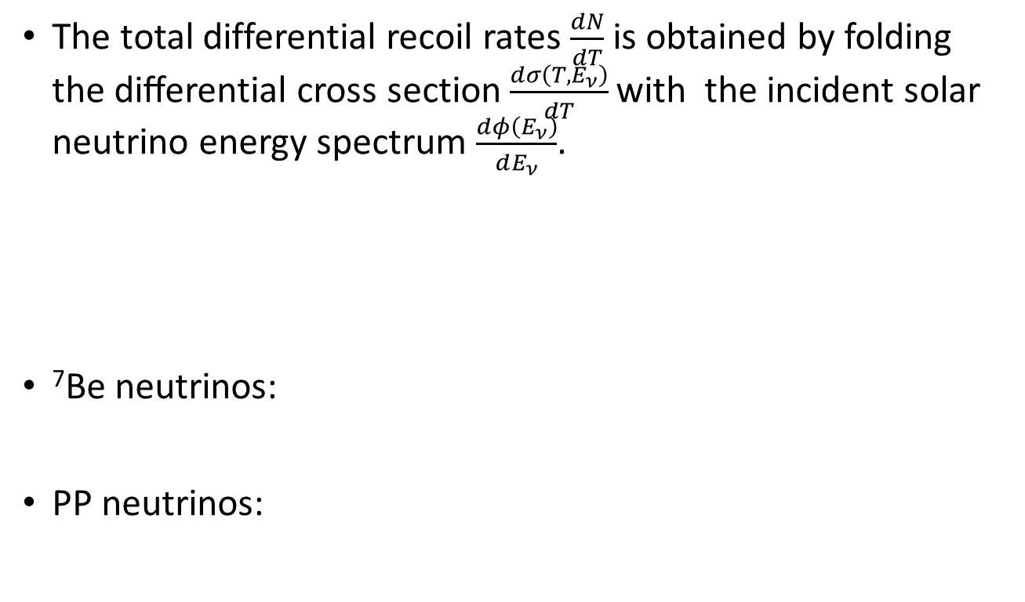


Event rates & solar neutrino flux
The total differential recoil rates $\frac{dN}{dT}$ is obtained by folding the diﬀerential cross section $\frac{dσ\left(T,E_{ν}\right)}{dT}$ with the incident solar neutrino energy spectrum $\frac{dφ\left(E_{ν}\right)}{dE_{ν}}$.
⁷Be neutrinos:
PP neutrinos:
$$\frac{dN}{dT}=\frac{6.02×{10}^{29}}{M_{xenon}}×t×\int{dE_{ν}\frac{dσ\left(T,E_{ν}\right)}{dT}\frac{dφ\left(E_{ν}\right)}{dE_{ν}}}$$
$$1 year$$
$$pp \& {}_{}^{7}{Be }neutrinos$$
$$φ_{{}_{}^{7}{Be }}=5.00×{10}^{9}{cm}^{−2}s^{−1}, 862 keV (89.6\%), 384 keV (10.4\%)$$
A. M. Serenelli, W. C. Haxton and C. Pena-Garay, Astrophys. J. 743, 24 (2011),
$$φ_{pp}=5.98×{10}^{10}{cm}^{−2}s^{−1}, \frac{dφ_{pp}\left(E_{ν}\right)}{dE_{ν}}=A\left(Q+m_{e}−E_{ν}\right){\left[{\left(Q+m_{e}−E_{ν}\right)}^{2}−{m_{e}}^{2}\right]}^{\frac{1}{2}}{E_{ν}}^{2}F$$
$$Q=420keV, A=2.97×{10}^{−36}{keV}^{2}$$
E. G. Adelberger et al., Rev. Mod. Phys. 83, 195 (2011).
J. N. Bahcall, Phys. Rev. C 56, 3391 (1997).

Slide 7

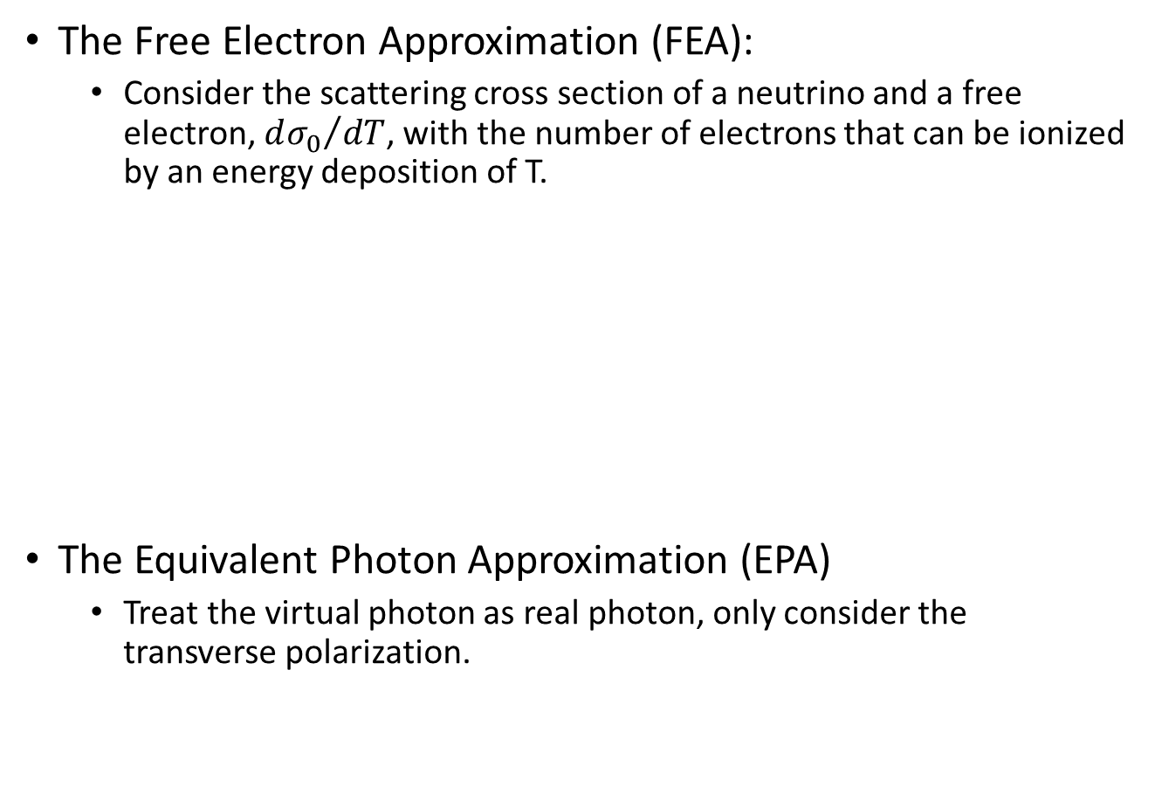
Other approximations
The Free Electron Approximation (FEA):
  Consider the scattering cross section of a neutrino and a free electron, ${dσ_{0}}/{dT}$, with the number of electrons that can be ionized by an energy deposition of T.
The Equivalent Photon Approximation (EPA)
  Treat the virtual photon as real photon, only consider the transverse polarization.
$$\frac{dσ}{dT}=\sum_{i=1}^{Z}{θ\left(T−B_{i}\right)\frac{dσ_{0}}{dT}}$$
Step function
Binding energy
J.-W. Chen, H.-C. Chi, K.-N. Huang, C.-P. Liu, H.-T. Shiao, et al., Phys. Lett. B 731, 159 (2014).
M. B. Voloshin, Phys. Rev. Lett. 105, 201801 (2010),
K. A. Kouzakov and A. I. Studenikin, Phys. Lett. B 696, 252 (2011).
J.-W. Chen, H.-C. Chi, H.-B. Li, C. P. Liu, L. Singh, H. T. Wong, C.-L. Wu, and C.-P. Wu, Phys. Rev. D 90, 011301 (2014), arXiv:1405.7168 [hep-ph].

Slide 8
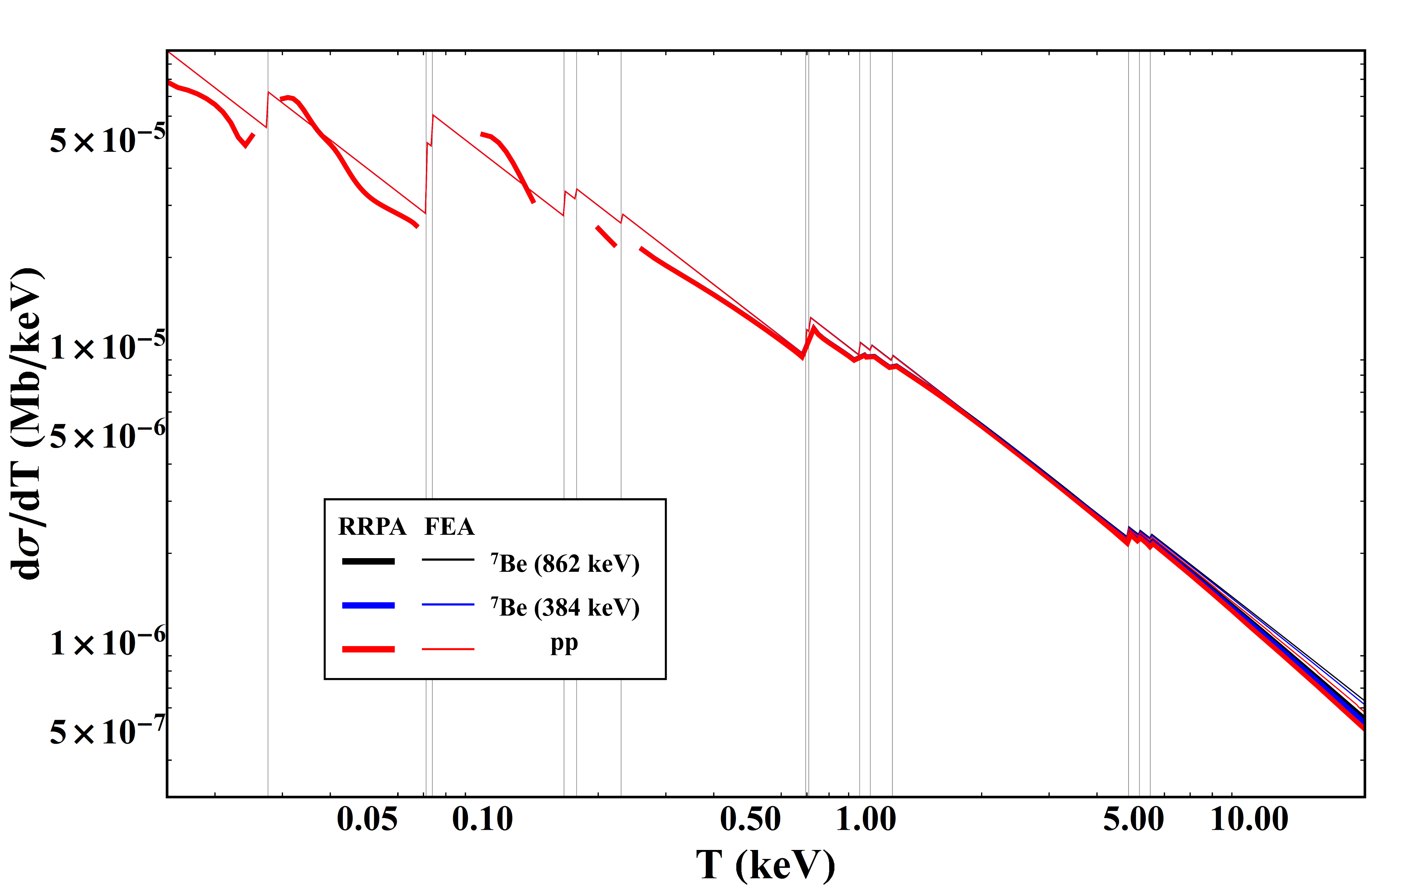
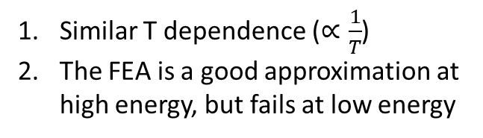
Result: magnetic moment
Similar T dependence ($∝\frac{1}{T}$)
The FEA is a good approximation at high energy, but fails at low energy

Slide 9
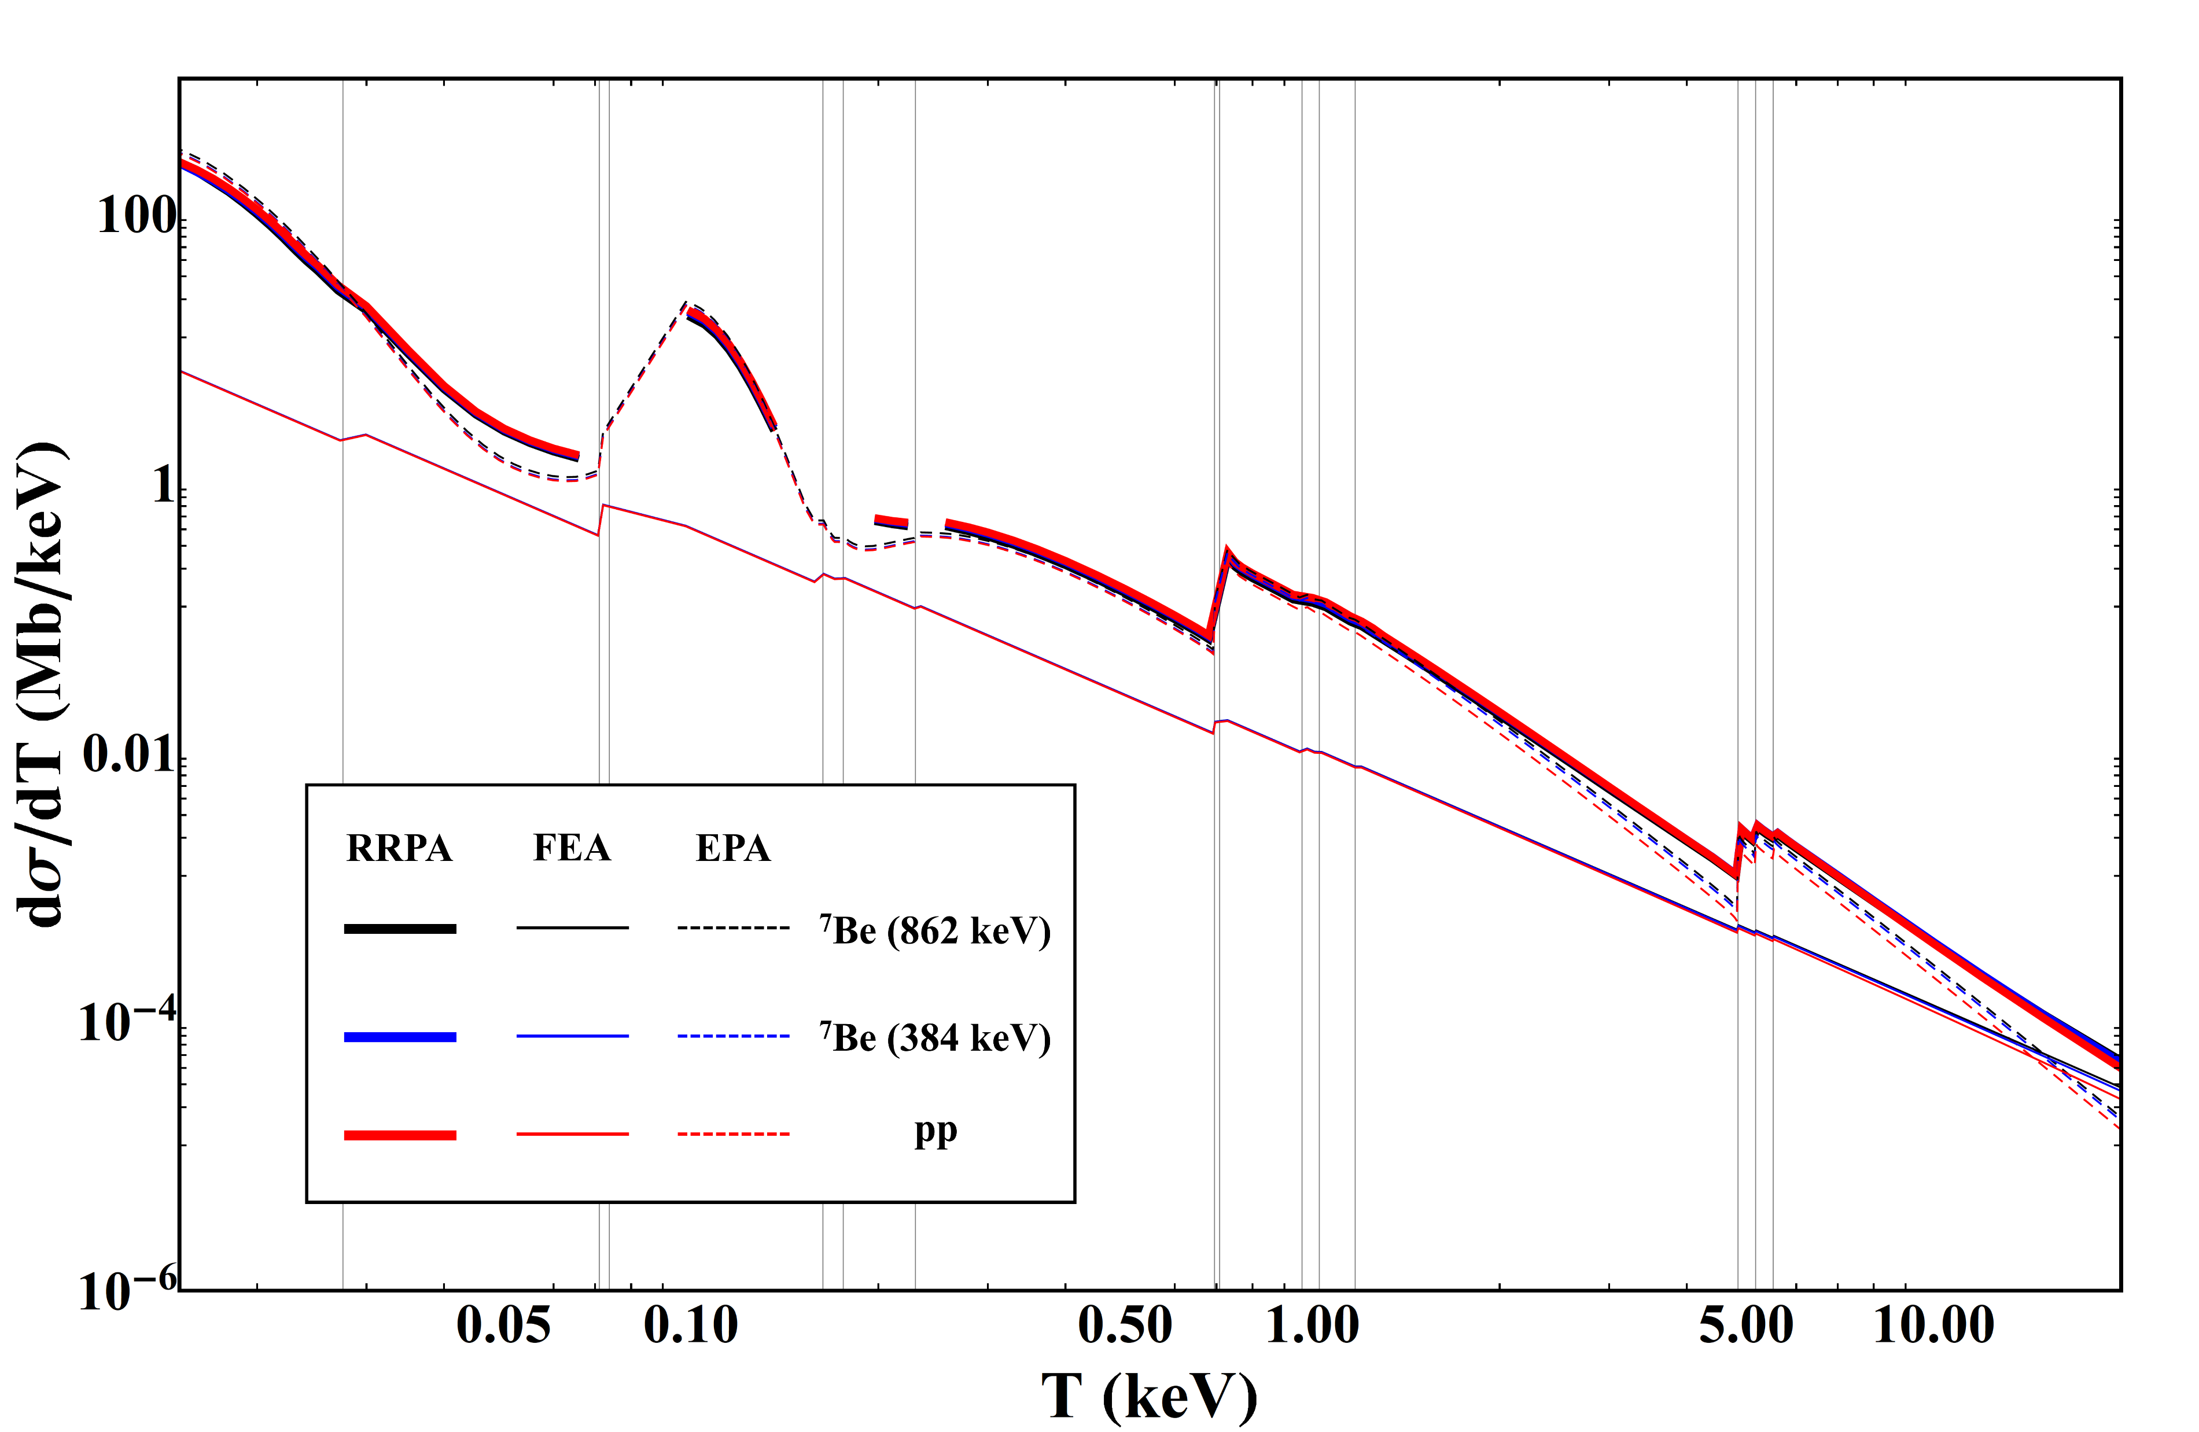

Result: millicharge
Larger T dependence $(∝\frac{1}{T^{2}})$
The EPA fits better at low energy, while FEA at high

Slide 10
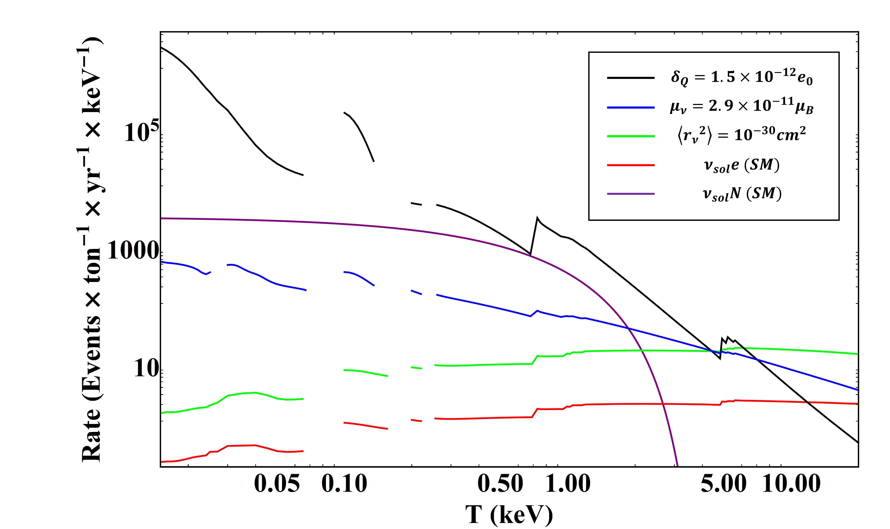
Complete event rates
A. Studenikin, (2013), arXiv:1302.1168 [hep-ph].
J.-W. Chen et al., Phys. Lett. B 731, 159 (2014), arXiv:1311.5294 [hep-ph].
Millicharge
Coherent scattering
Magnetic moment
Charge radius
Weak interaction
Scale up
Lower the energy threshold
Discrimination at low energy
Weak interaction: background

Slide 11
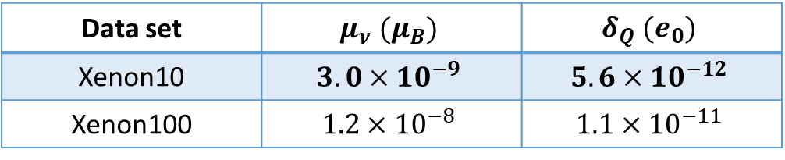
Constraining neutrino properties
Using Xenon10 and Xenon100 data
Transform the differential cross section into photoelectron signals and obtain a set of suggestive constrain values.
Results (1 kg-day):
The results are larger than the current best constraints by a factor of 4 (millicharge), but with multi-ton year exposure the constrain values could be improved by 2 orders.
Data set | $$μ_{ν} (μ_{B})$$ | $$δ_{Q} (e_{0})$$
Xenon10 | $$3.0×{10}^{−9}$$ | $$5.6×{10}^{−12}$$
Xenon100 | $$1.2×{10}^{−8}$$ | $$1.1×{10}^{−11}$$

Slide 12
Summary
The contribution of this study is 2-fold: provide background for light WIMP direct search and constrain the EM properties of neutrinos.
The differential cross section of magnetic moment and millicharged interaction are both enhanced at low T, where the atomic effects become important.
The results are not as good as the current best constraints, but with multi-ton year exposure the constrain values using xenon detectors are projected to improve.

Slide 13
Thanks for listening & Happy new year!

Slide 14
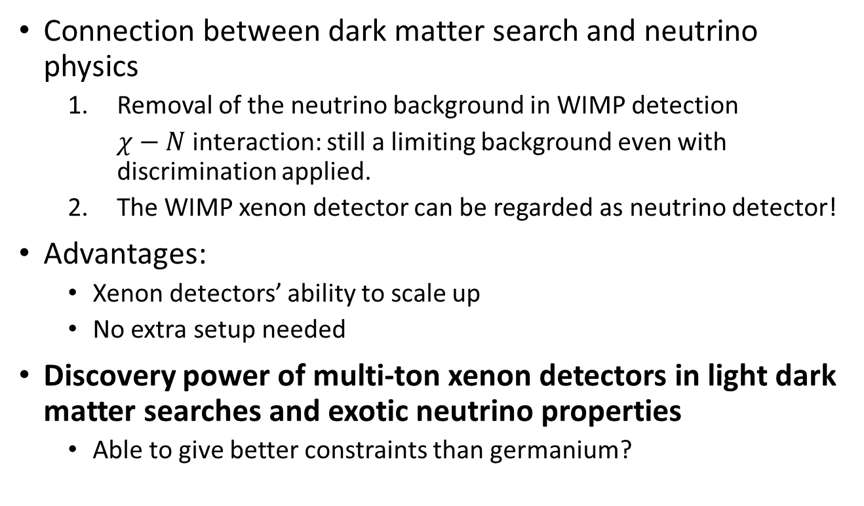
Introduction
Connection between dark matter search and neutrino physics
  Removal of the neutrino background in WIMP detection
    $χ−N$ interaction: still a limiting background even with discrimination applied.
  The WIMP xenon detector can be regarded as neutrino detector!
Advantages:
  Xenon detectors’ ability to scale up
  No extra setup needed
Discovery power of multi-ton xenon detectors in light dark matter searches and exotic neutrino properties
  Able to give better constraints than germanium?

Slide 15

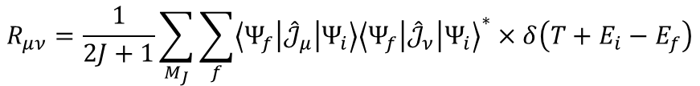
Formalism
Differential cross section:
Magnetic moment interaction:
Millicharge interaction:
Where $R_{μν}^{}$ is the response function:
$$\frac{dσ_{μ}}{dT}={μ_{ν}}^{2}\left(2πα^{2}\right)\left(1−\frac{T}{E_{ν}}\right)\int{d\cos{θ}\left\{−\frac{{\left(2E_{ν}−T\right)}^{2}q^{2}}{{\left|\overset{⃑}{q}\right|}^{4}}R_{00}^{}−\left[\frac{q^{2}+4E_{ν}\left(E_{ν}−T\right)}{2{\left|\overset{⃑}{q}\right|}^{2}}+\frac{1}{q^{2}}\right]R_{11+22}^{}\right\}}$$
$$\frac{dσ_{δ_{Q}}}{dT}={δ_{Q}}^{2}\left(2πα^{2}\right)\left(1−\frac{T}{E_{ν}}\right)\int{d\cos{θ}\left\{−\frac{{\left(2E_{ν}−T\right)}^{2}−{\left|\overset{⃑}{q}\right|}^{2}}{{\left|\overset{⃑}{q}\right|}^{4}}R_{00}^{}−\left[\frac{q^{2}+4E_{ν}\left(E_{ν}−T\right)}{2{\left|\overset{⃑}{q}\right|}^{2}q^{2}}+\frac{1}{q^{2}}\right]R_{11+22}^{}\right\}}$$
$$R_{μν}^{}=\frac{1}{2J+1}\sum_{M_{J}}{\sum_{f}{\left\langle Ψ_{f} | {\hat{𝒥}}_{μ} | Ψ_{i}\right\rangle {\left\langle Ψ_{f} | {\hat{𝒥}}_{ν} | Ψ_{i}\right\rangle }^{∗}×δ\left(T+E_{i}−E_{f}\right)}}$$

Slide 16
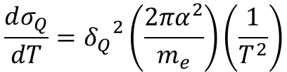
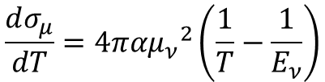
Formalism
Differential cross section with FEA
$$\frac{dσ_{μ}}{dT}=4πα{μ_{ν}}^{2}\left(\frac{1}{T}−\frac{1}{E_{ν}}\right)$$
$$\frac{dσ_{Q}}{dT}={δ_{Q}}^{2}\left(\frac{2πα^{2}}{m_{e}}\right)\left(\frac{1}{T^{2}}\right)$$

Slide 17
Formalism
Atomic effects become important.
Ab initio method: Relativistic Random Phase Approximation, RRPA
  Hatree-Fock: Reduce the many body system to single particle problem by effective mean field with self consistency.
  RPA: Including electron-pole pair excitation
  RRPA: Adding relativistic effects, for closed orbitals e.g. xenon.

Slide 18
Benchmark calculation: Xe photoionization
Within 5% errors
Some energy range cannot reach convergence

Slide 19
References
[1] M. Tanabashi et al. (Particle Data Group), Phys. Rev. D 98, 030001 (2018).
[2] H. B. Li et al., Phys. Rev. Lett. 90, 131802 (2003).
[3] H. T. Wong et al., Phys. Rev. D 75, 012001 (2007).
[4] A. Beda et al., Adv. High Energy Phys. 2012, 350150 (2012).
[5] A. G. Beda et al., Phys. Part. Nucl. Lett. 10, 139 (2013).
[6] S. Gninenko, N. Krasnikov, and A. Rubbia, Phys. Rev. D 75, 075014 (2007),
arXiv:hepph/0612203 [hep-ph].
[7] A. Studenikin, (2013), arXiv:1302.1168 [hep-ph].
[8] J. Billard, L. Strigari, and E. Figueroa-Feliciano, Phys. Rev. D 89, 023524 (2014),
arXiv:1307.5458 [hep-ph].
[9] J.-W. Chen, H.-C. Chi, K.-N. Huang, C.-P. Liu, H.-T. Shiao, et al., Phys. Lett. B 731, 159
(2014), arXiv:1311.5294 [hep-ph].
[10] J.-W. Chen, H.-C. Chi, H.-B. Li, C. P. Liu, L. Singh, H. T. Wong, C.-L. Wu, and C.-P. Wu,
Phys. Rev. D 90, 011301 (2014), arXiv:1405.7168 [hep-ph].
[11] J.-W. Chen, H.-C. Chi, K.-N. Huang, H.-B. Li, C.-P. Liu, L. Singh, H. T. Wong, C.-L. Wu,
and C.-P. Wu, Phys. Rev. D 91, 013005 (2015), arXiv:1411.0574 [hep-ph].
[12] J.-W. Chen, H.-C. Chi, C. P. Liu, and C.-P. Wu, Phys. Lett. B 774, 656 (2016),
arXiv:1610.04177 [hep-ex].
[13] W. R. Johnson and C. D. Lin, Phys. Rev. A 20, 964 (1979).
[14] W. R. Johnson and K. T. Cheng, Phys. Rev. A 20, 978 (1979).
[15] K.-N. Huang, W. R. Johnson, and K. T. Cheng, At. Data Nucl. Data Tables 26, 33 (1981).
[16] K.-N. Huang and W. R. Johnson, Phys. Rev. A 25, 634 (1982).
[17] J.B. West and J. Morton, At. Data Nucl. Data Tables 22 (1978) 103.
[18] B.L. Henke, E.M. Gullikson, J.C. Davis, At. Data Nucl. Data Tables 54 (1993) 181.
[19] J. Samson, W. Stolte, J. Electron Spectrosc. Relat. Phenom. 123 (2002) 265.
[20] I.H. Suzuki, N. Saito, J. Electron Spectrosc. Relat. Phenom. 129 (2003) 71.
[21] L. Zheng, M. Cui, Y. Zhao, J. Zhao, K. Chen, J. Electron Spectrosc. Relat. Phenom. 152
(2006) 143.
[22] A. M. Serenelli, W. C. Haxton and C. Pena-Garay, Astrophys. J. 743, 24 (2011)
doi:10.1088/0004-637X/743/1/24 [arXiv:1104.1639 [astro-ph.SR]].
[23] E. G. Adelberger et al., Rev. Mod. Phys. 83, 195 (2011) doi:10.1103/RevModPhys.83.195
[arXiv:1004.2318 [nucl-ex]].
[24] J. N. Bahcall, Phys. Rev. C 56, 3391 (1997) doi:10.1103/PhysRevC.56.3391 [hep-ph/9710491].
[25] J. N. Bahcall and C. Pena-Garay, New J. Phys. 6, 63 (2004) doi:10.1088/1367-2630/6/1/063
[hep-ph/0404061].
[26] K. A. Olive et al. [Particle Data Group], Chin. Phys. C 38, 090001 (2014). doi:10.1088/1674
1137/38/9/090001
[27] A. M. Serenelli, W. C. Haxton, and C. Pena-Garay, Astrophys. J. 743, 24 (2011),
arXiv:1104.1639 [astro-ph.SR].
[28] E. G. Adelberger et al., Rev. Mod. Phys. 83, 195 (2011), arXiv:1004.2318 [nucl-ex].
[29] J. N. Bahcall, A. M. Serenelli, and S. Basu, Astrophys. J. 621, L85 (2005), arXiv:astro
ph/0412440 [astro-ph].
[30] M. B. Voloshin, Phys. Rev. Lett. 105, 201801 (2010), erratum: ibid. 106, 059901 (2011).
10
[31] K. A. Kouzakov and A. I. Studenikin, Phys. Lett. B 696, 252 (2011).
[32] K. A. Kouzakov, A. I. Studenikin, and M. B. Voloshin, Phys. Rev. D 83, 113001 (2011).
[33] V. B. Brudanin, D. V. Medvedev, A. S. Starostin , A. I. Studenikin, Nucl. Part. Phys. Proc.,
273275, 2605-2608 (2016).
[34] J. Angle, et al. (XENON Collaboration), Phys. Rev. D 80, 115005 (2009)
[35] S. Kerman et al. [TEXONO Collaboration], Phys. Rev. D 93, no. 11, 113006 (2016)
doi:10.1103/PhysRevD.93.113006 [arXiv:1603.08786 [hep-ph]].

